Slide 1

The logo indicates unfolding shackles using
Unhack app.

Slide 2
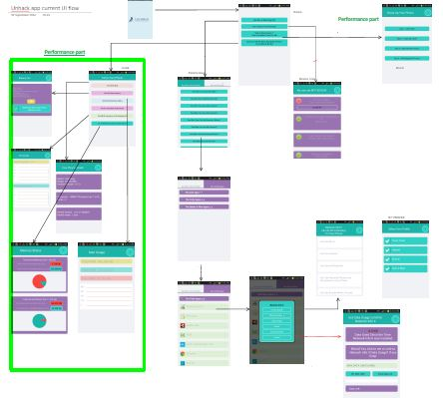
Analysis of existing UI flow
* Screenshot from One-Note file
Info + Performance
Security
Privacy
Please make the device faster.
Tell me more about my device!
Am I secure from attacks ?
See who is watching me?

Slide 3
Insights
Ambiguity in navigation labels. Am I secure from attacks and
Who is watching me , both menu options sound ambiguous to the user and
makes him confused about the content that follows.
Absence of proper visual feedback to the user about the current status of
the app. Navigating from one screen to the other doesn’t displays the transition
in either hierarchical or through breadcrumbs.
Permissions options for apps has a lot of text in the interface which slows
the user down.
Information is not present in a consistent style and format.
To reach to the home screen user has to go all the way back to the first
page tapping the back button which is not recommended as it is frustrating
for the user to perform such tedious task.

Slide 4
Inference
So,
We are focusing here on three things :
Privacy
Security
Info+Performance

Slide 5
My focus
I,
will be focusing here on :
Privacy
Security
Info+Performance

Slide 6
Approach
Let user see data upfront

Slide 7
Approach
Take well informed decisions

Slide 8
Earlier proposed Information Architecture
Splash screen
Prudent Level
Precaution Level
SOS Level
Check Phone Health
Boost Phone Health
Scan device for possible threats.
Display apps &
there permissions
Battery info,
Process,
Ram usage,
Memory status
Etc.
Clean cache etc.
Set a profile.
Revoke permissions
, uninstall apps

Slide 9

New modified Information Architecture
Splash screen
1
Help
Home screen
Notifications
Level
Scan
Phone
Apps
Is Device secure?
Display profile
Search apps
2
Scan for threats
Phone health
App filter
User takes action
Boost phone
Check app info
Level
Clean cache
Kill background processes
Clean browser history
End
End
End

Slide 10

Persona
“ I want my smartphone to be fast,
malware free and at the same time
have a better battery backup.”
Touch points
Main Usage
Jenifer
Nexus 5
Uses 3G,wifi
Has more than
20 apps in her
phone.
Time table plan
Social networking
Games.
Calling a lot
Female,
23
College
Student
Pain points
Objectives
Battery drains fast
Apps crash down
Phone becomes slow
after some use.
Internal memory
becomes low.
Batter battery
management
Full privacy in terms
of intruding apps.
Doesn’t want too much
technical details.
Easy clean up and speed
boost of cell phone.

Slide 11
Scenario
“ Jenifer’s phone is running very slow
and its high time she checks her
app’s permissions and the phone’s
battery usage.”

Slide 12
Brainstorming

Slide 13
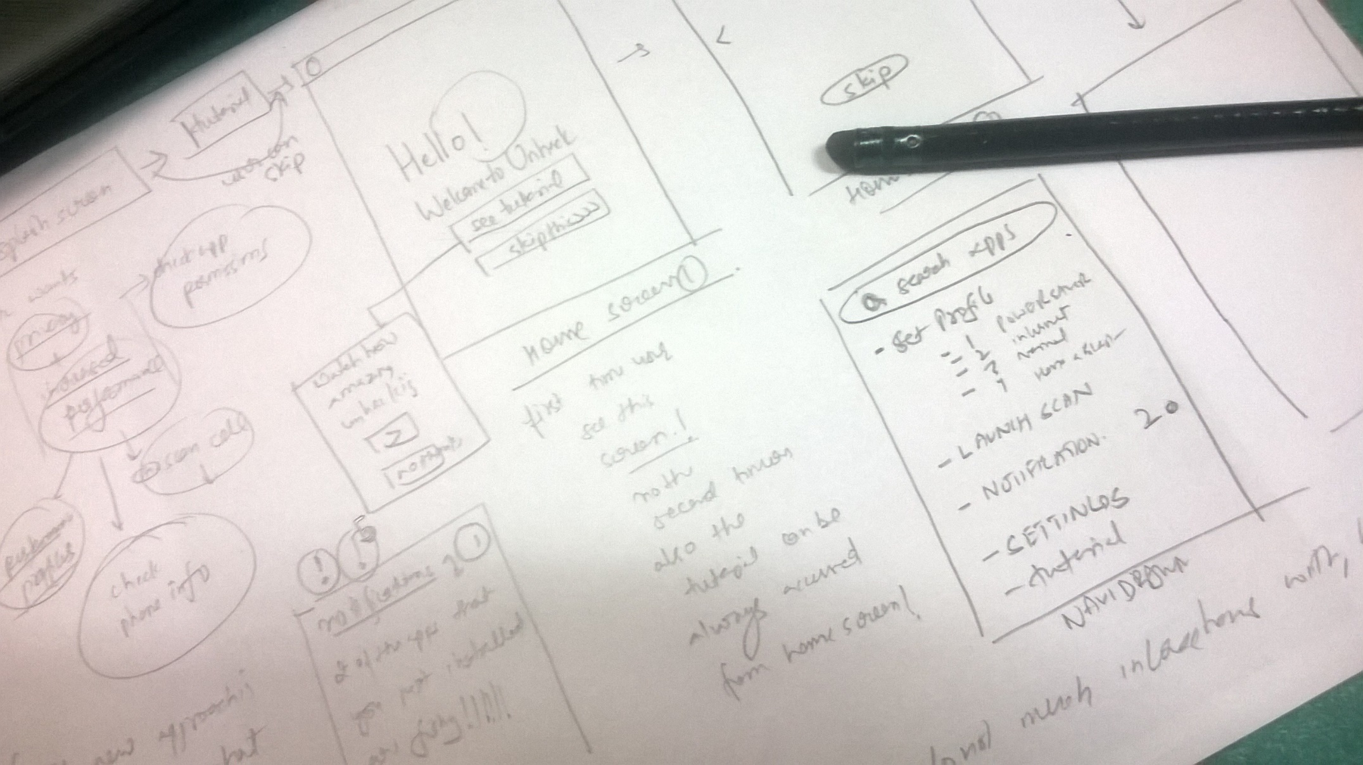
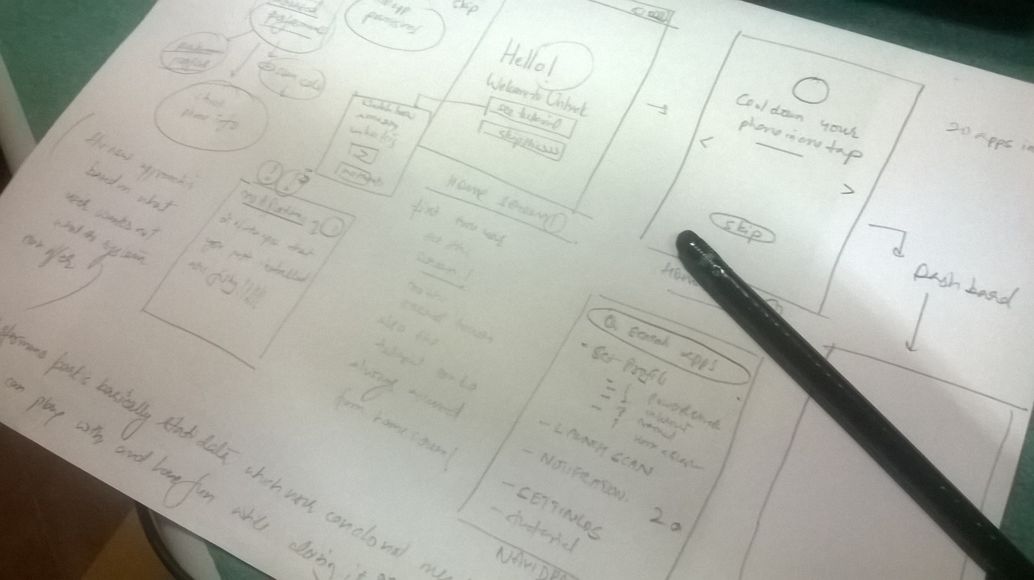
Paper sketches

Slide 14
Wireframes

Slide 15
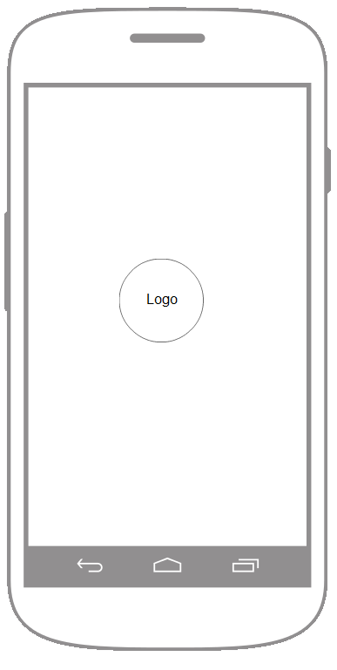
Splash screen

Slide 16
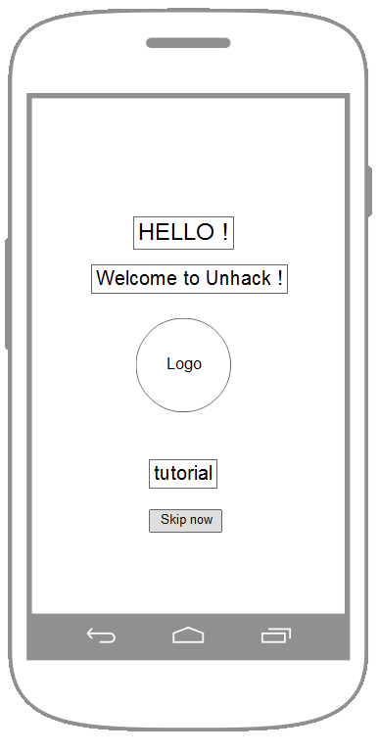
Welcome screen

Slide 17
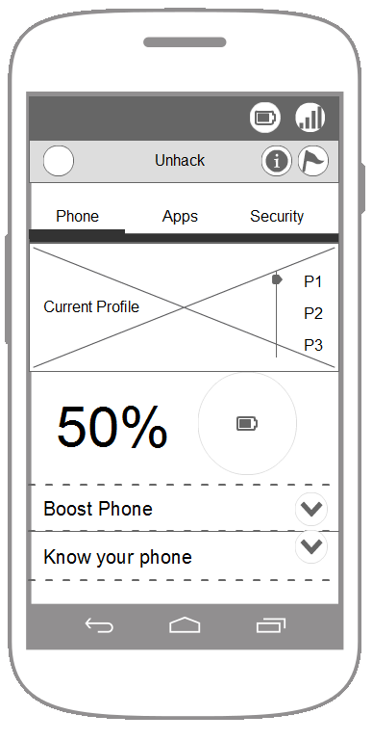
Phone Tab screen

Slide 18
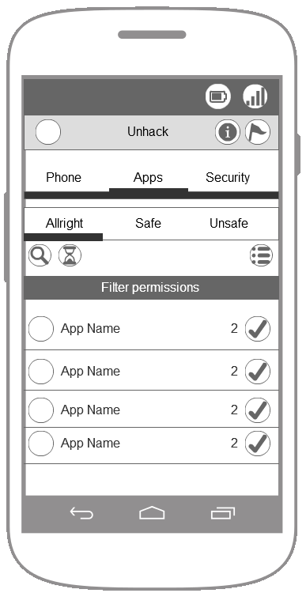
Apps Tab screen

Slide 19
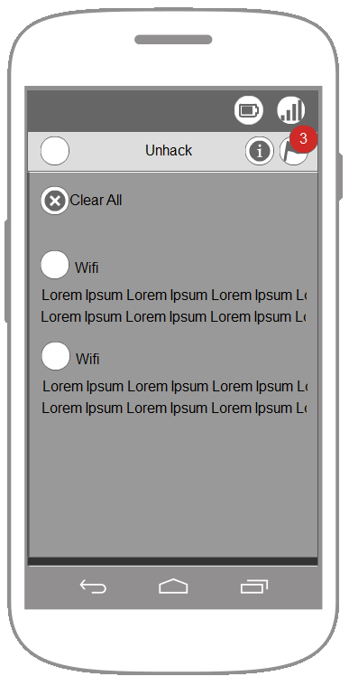
Notifications screen

Slide 20
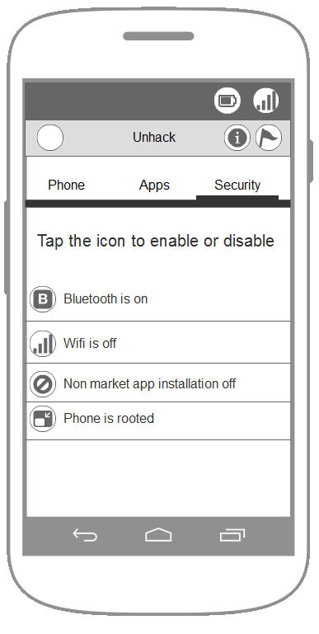
Security ab screen

Slide 21
Visual Mock-ups

Slide 22
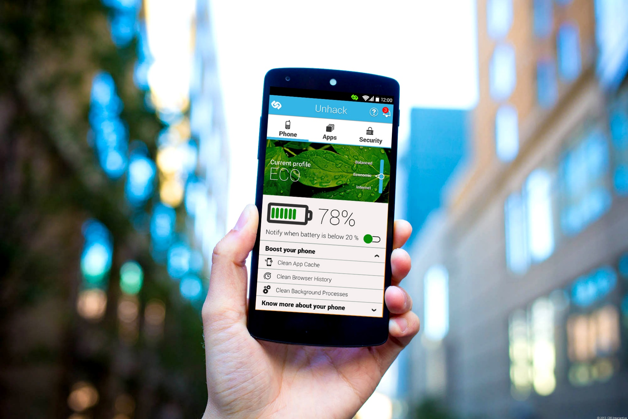
Unhack mobile application

Slide 23
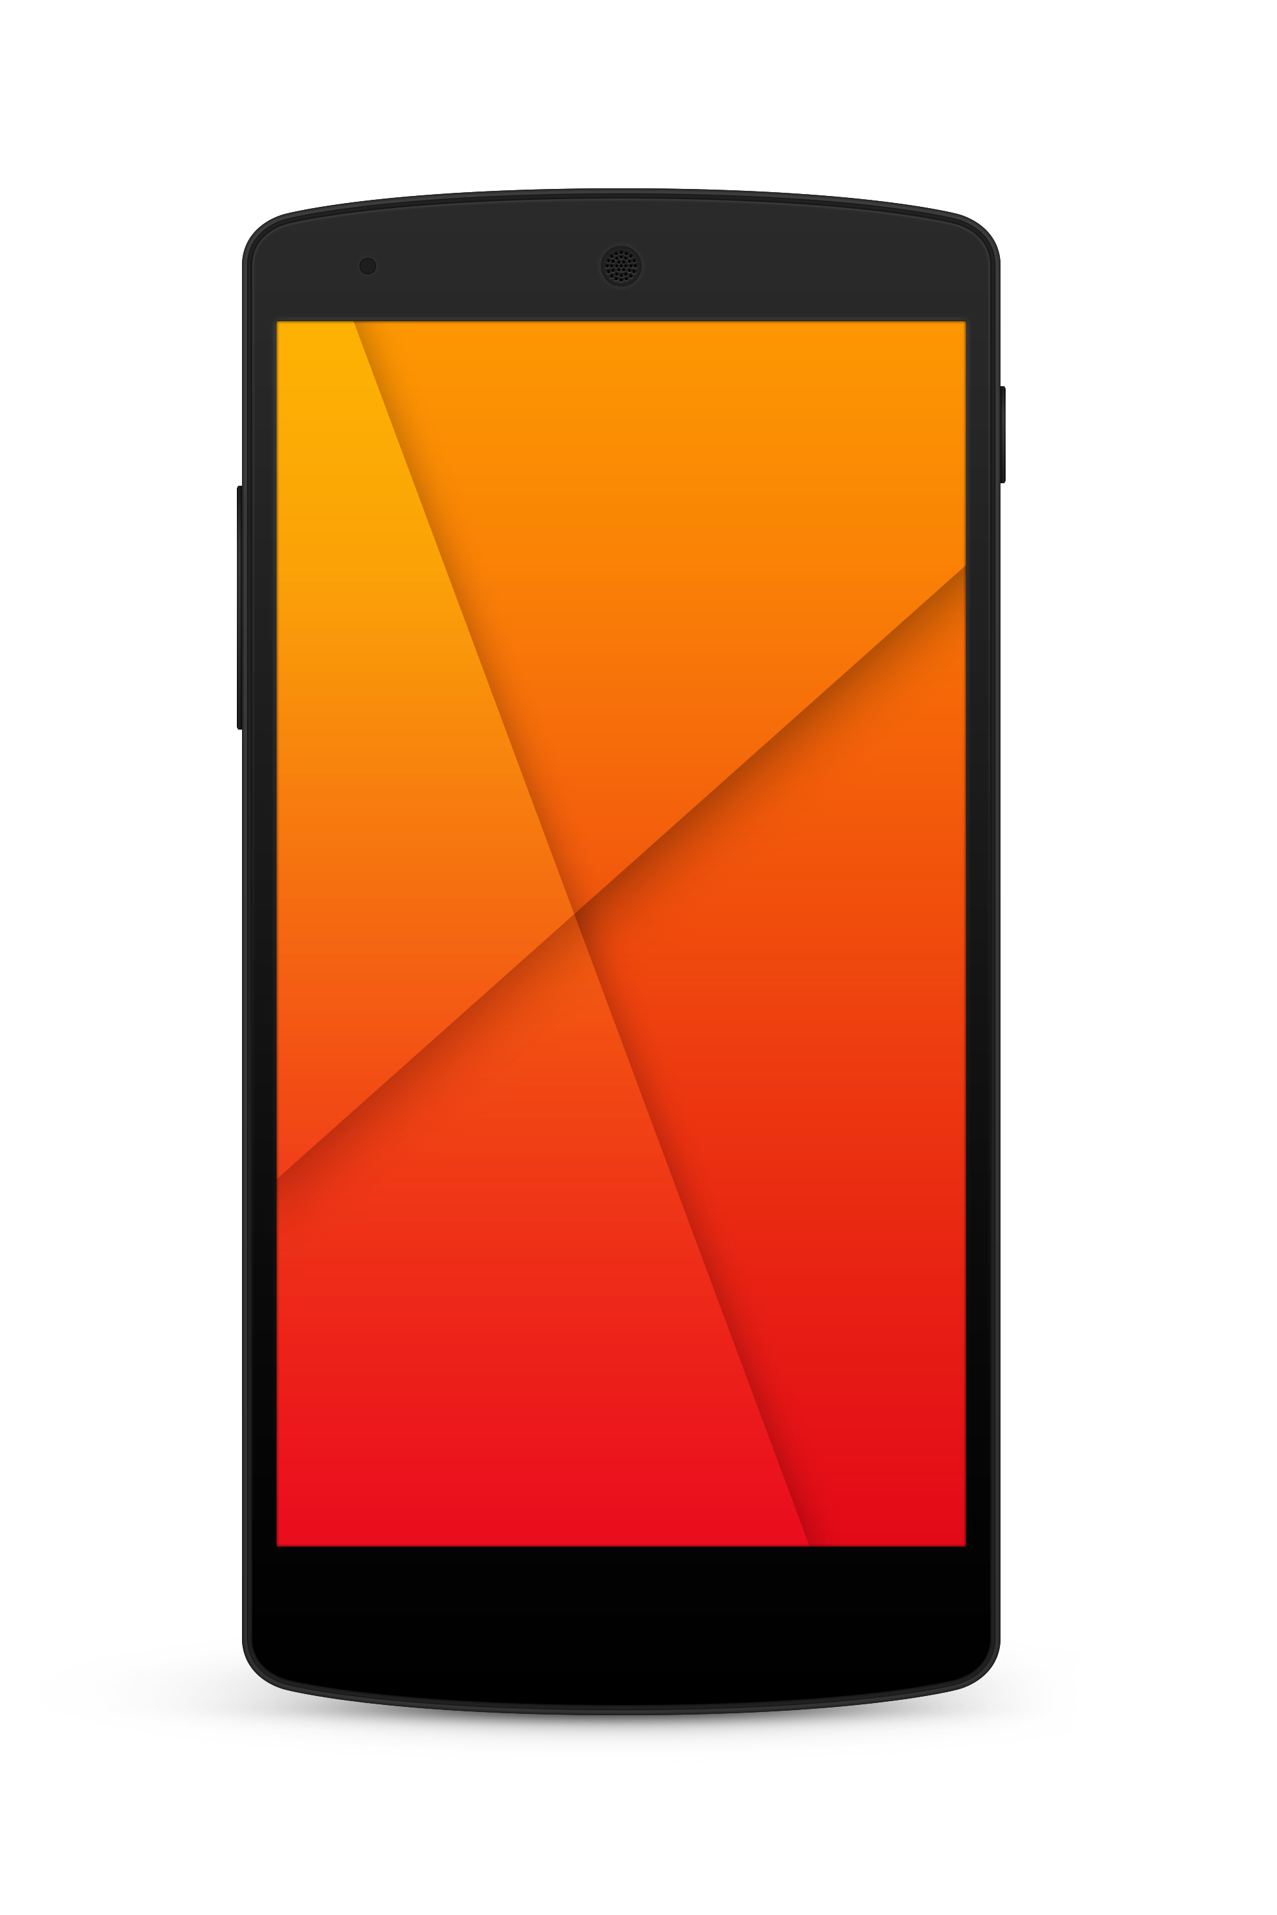

Landing screen

Slide 24
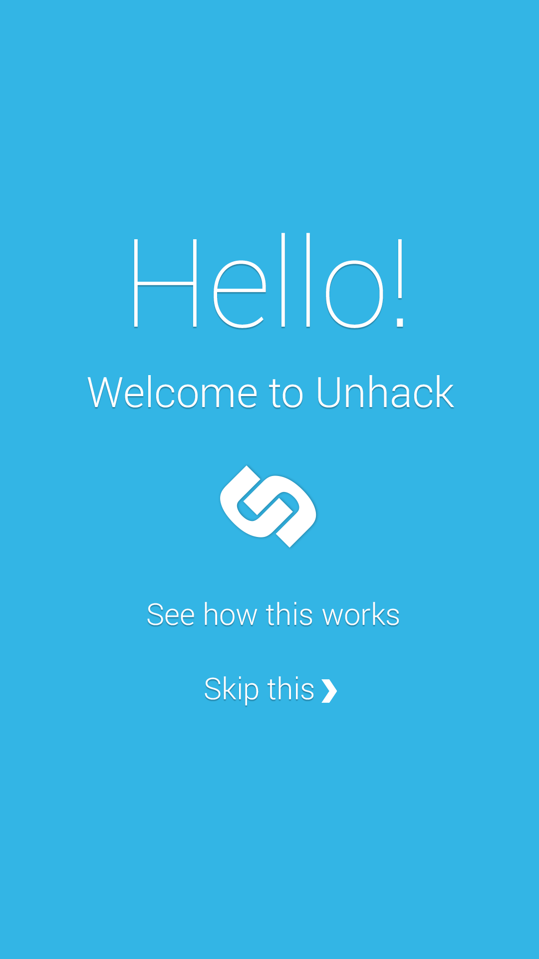
Welcome screen

Slide 25
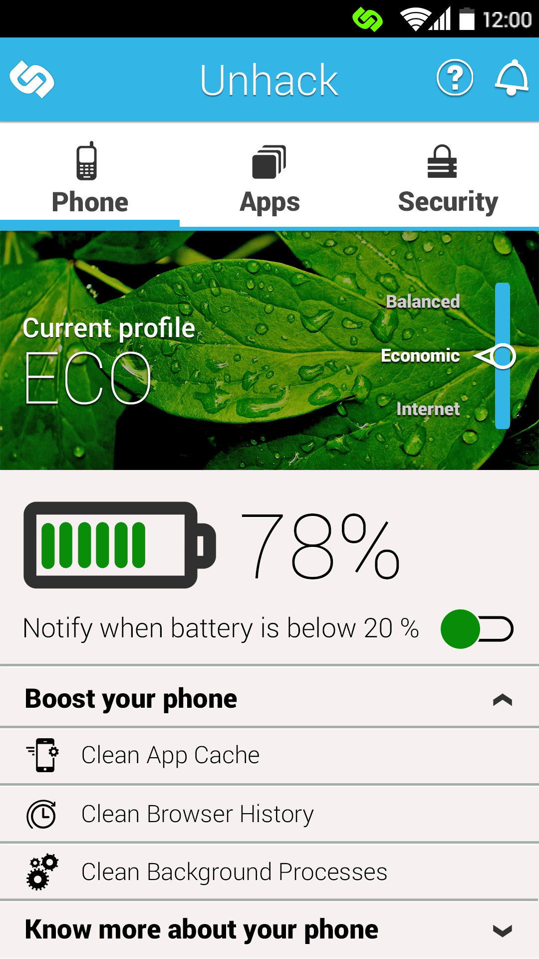
Phone tab screen

Slide 26
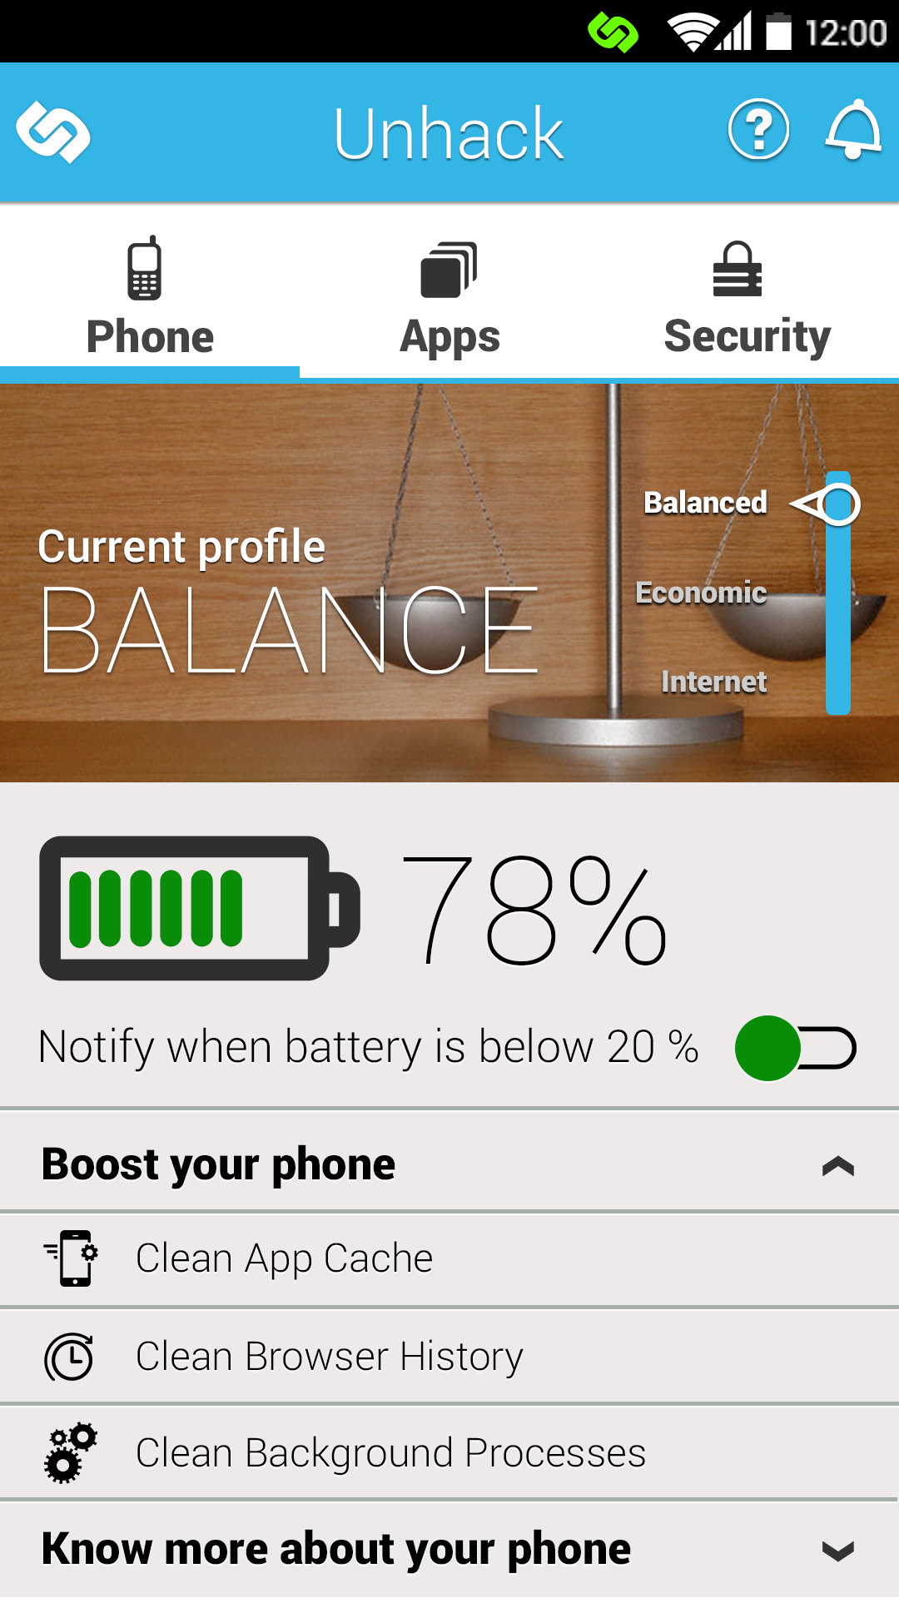
Phone tab Balanced mode screen

Slide 27
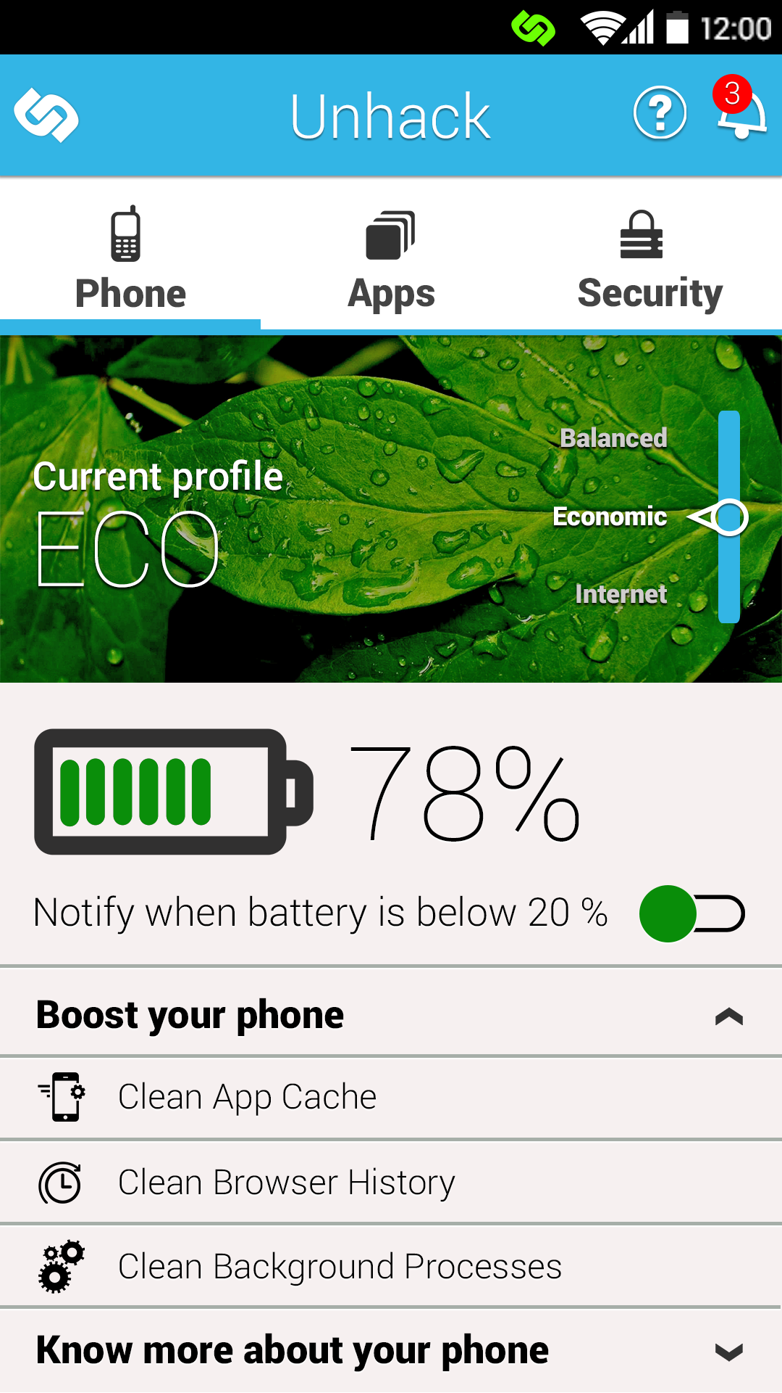
Apps tab notification screen

Slide 28
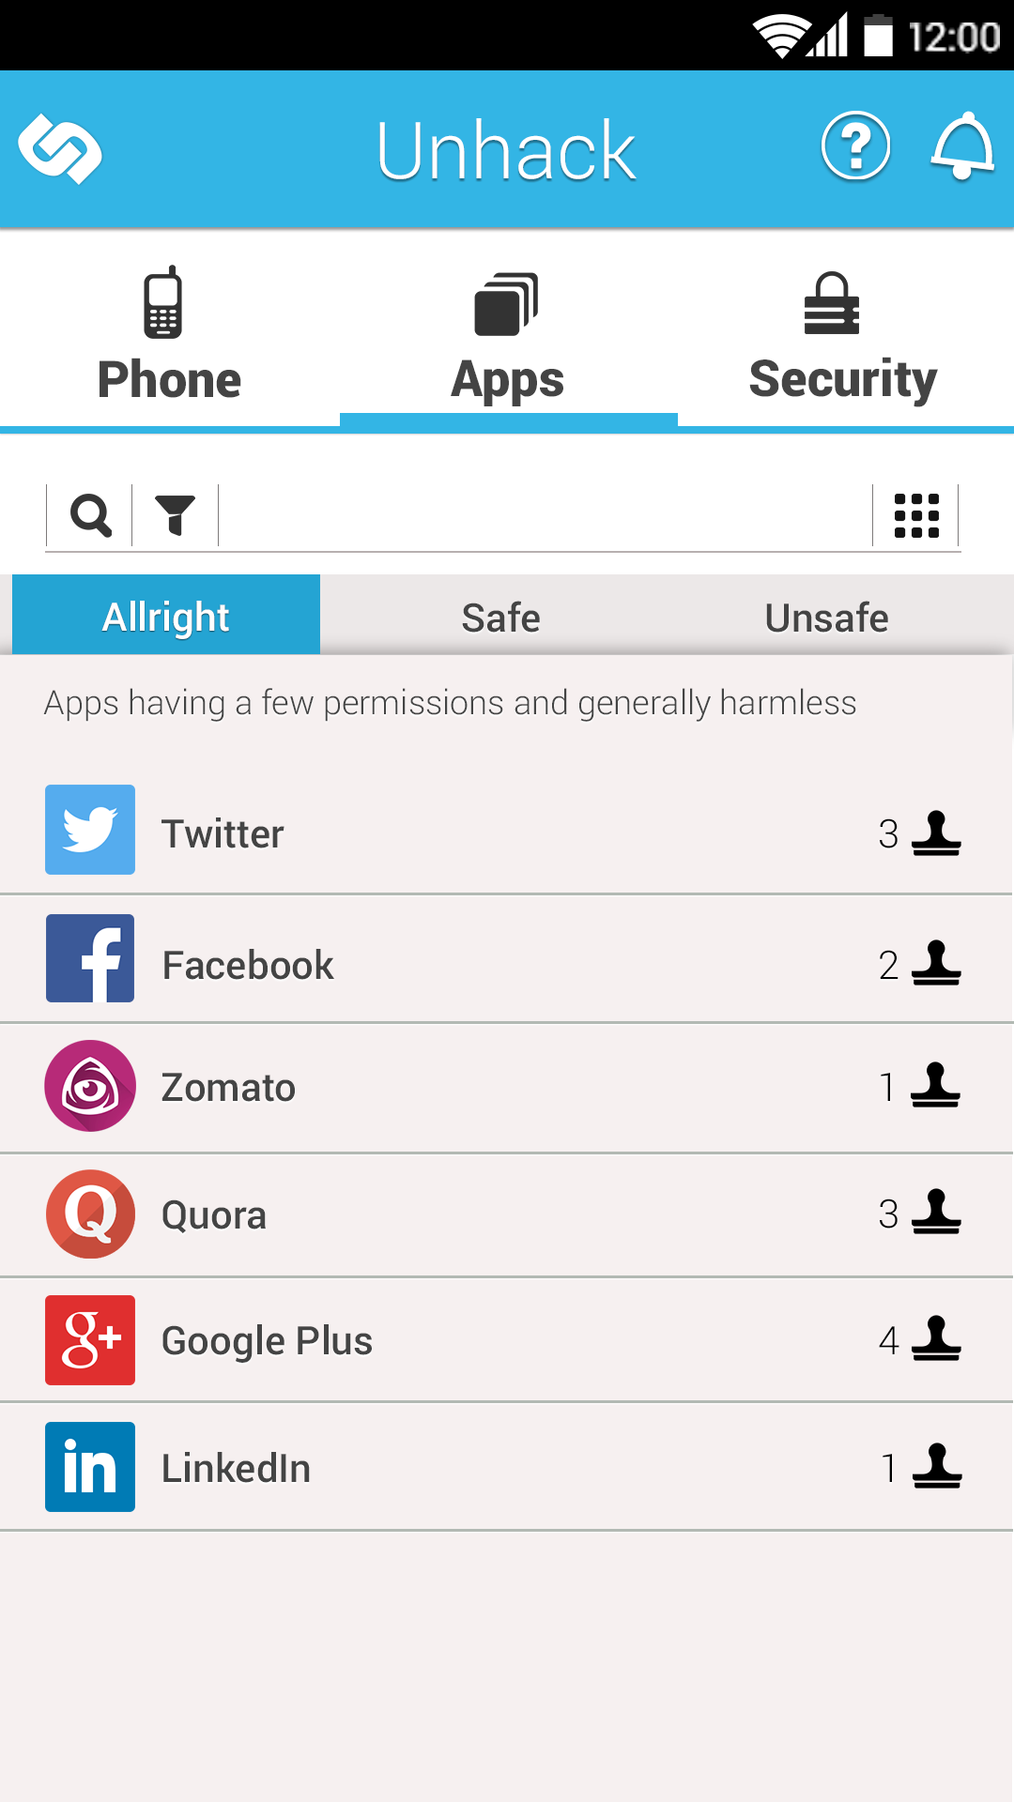
Phone tab notification screen

Slide 29
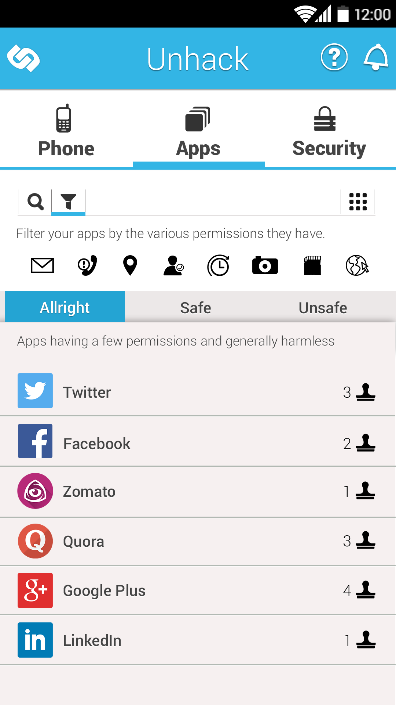
Apps tab filters notification screen

Slide 30
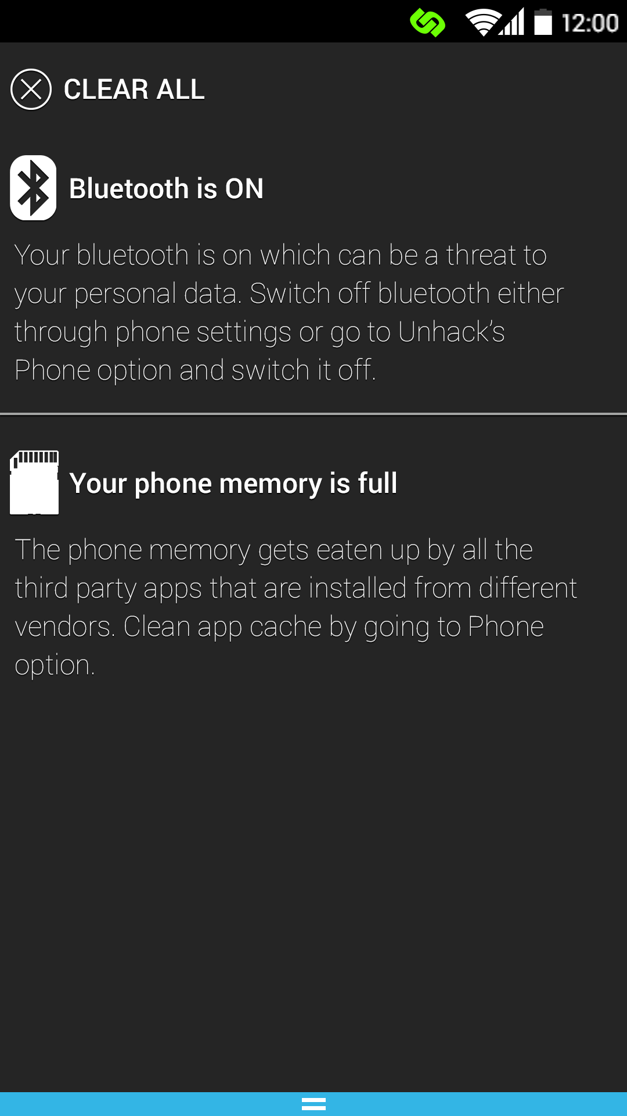
Phone tab notification screen

Slide 31
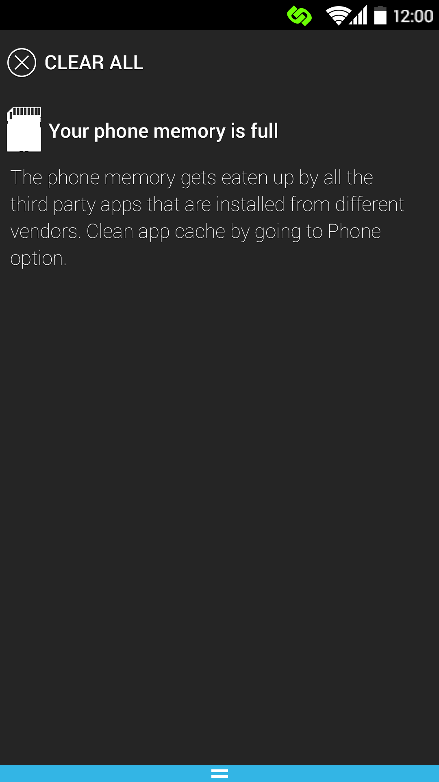
Phone tab notification screen

Slide 32
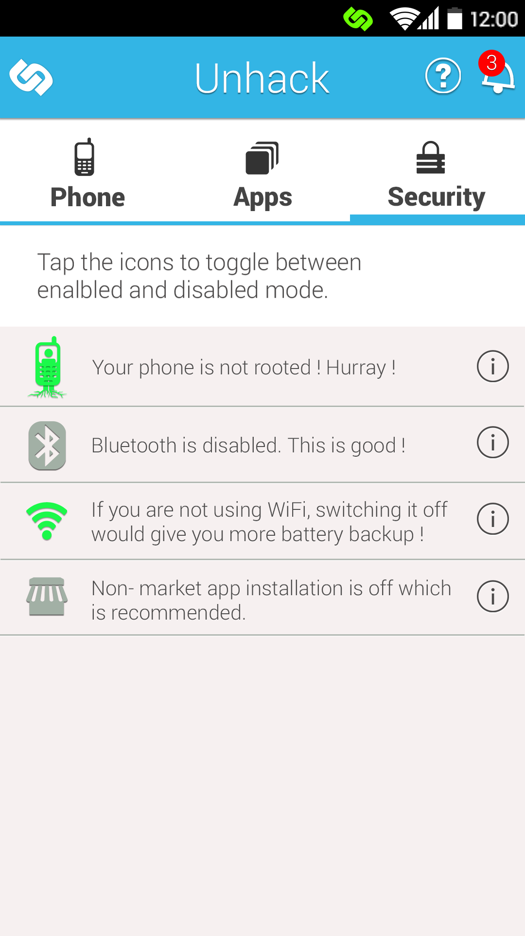
Phone tab notification screen

Slide 33
Booklet

Slide 34
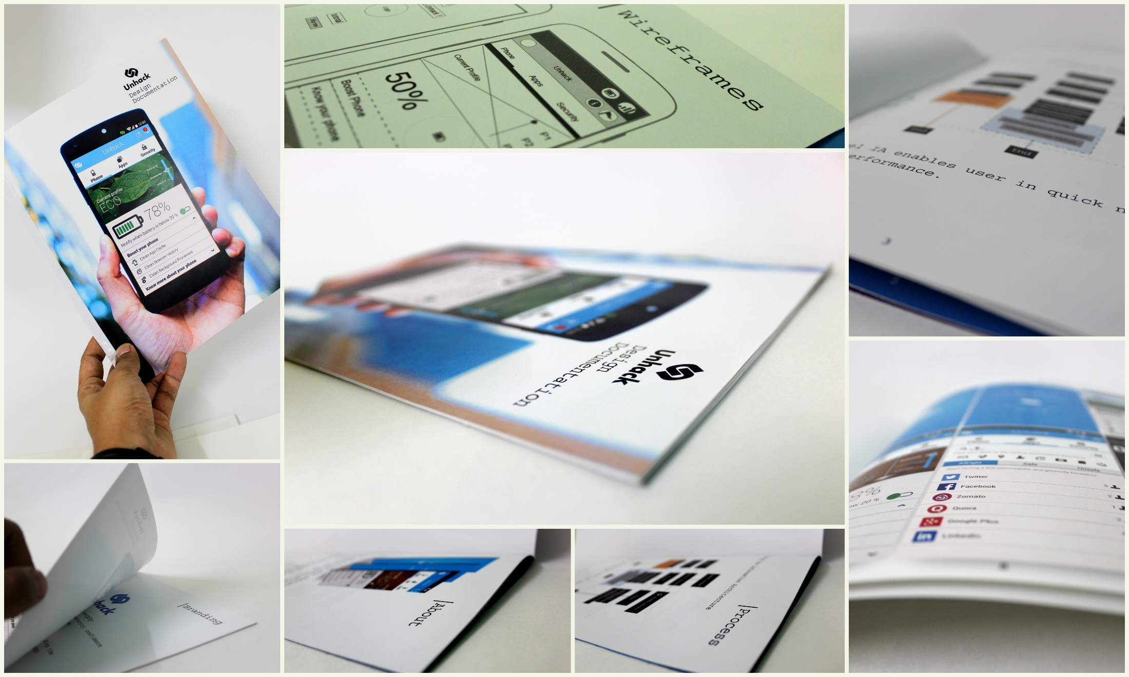
Booklet

Slide 35
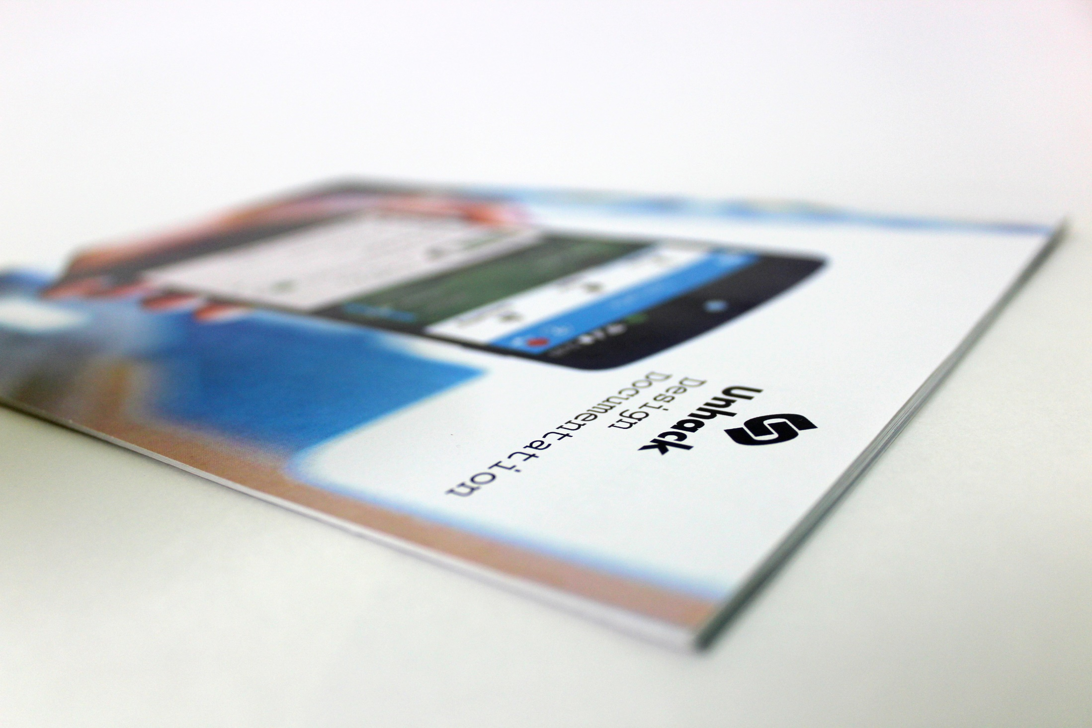

Slide 36
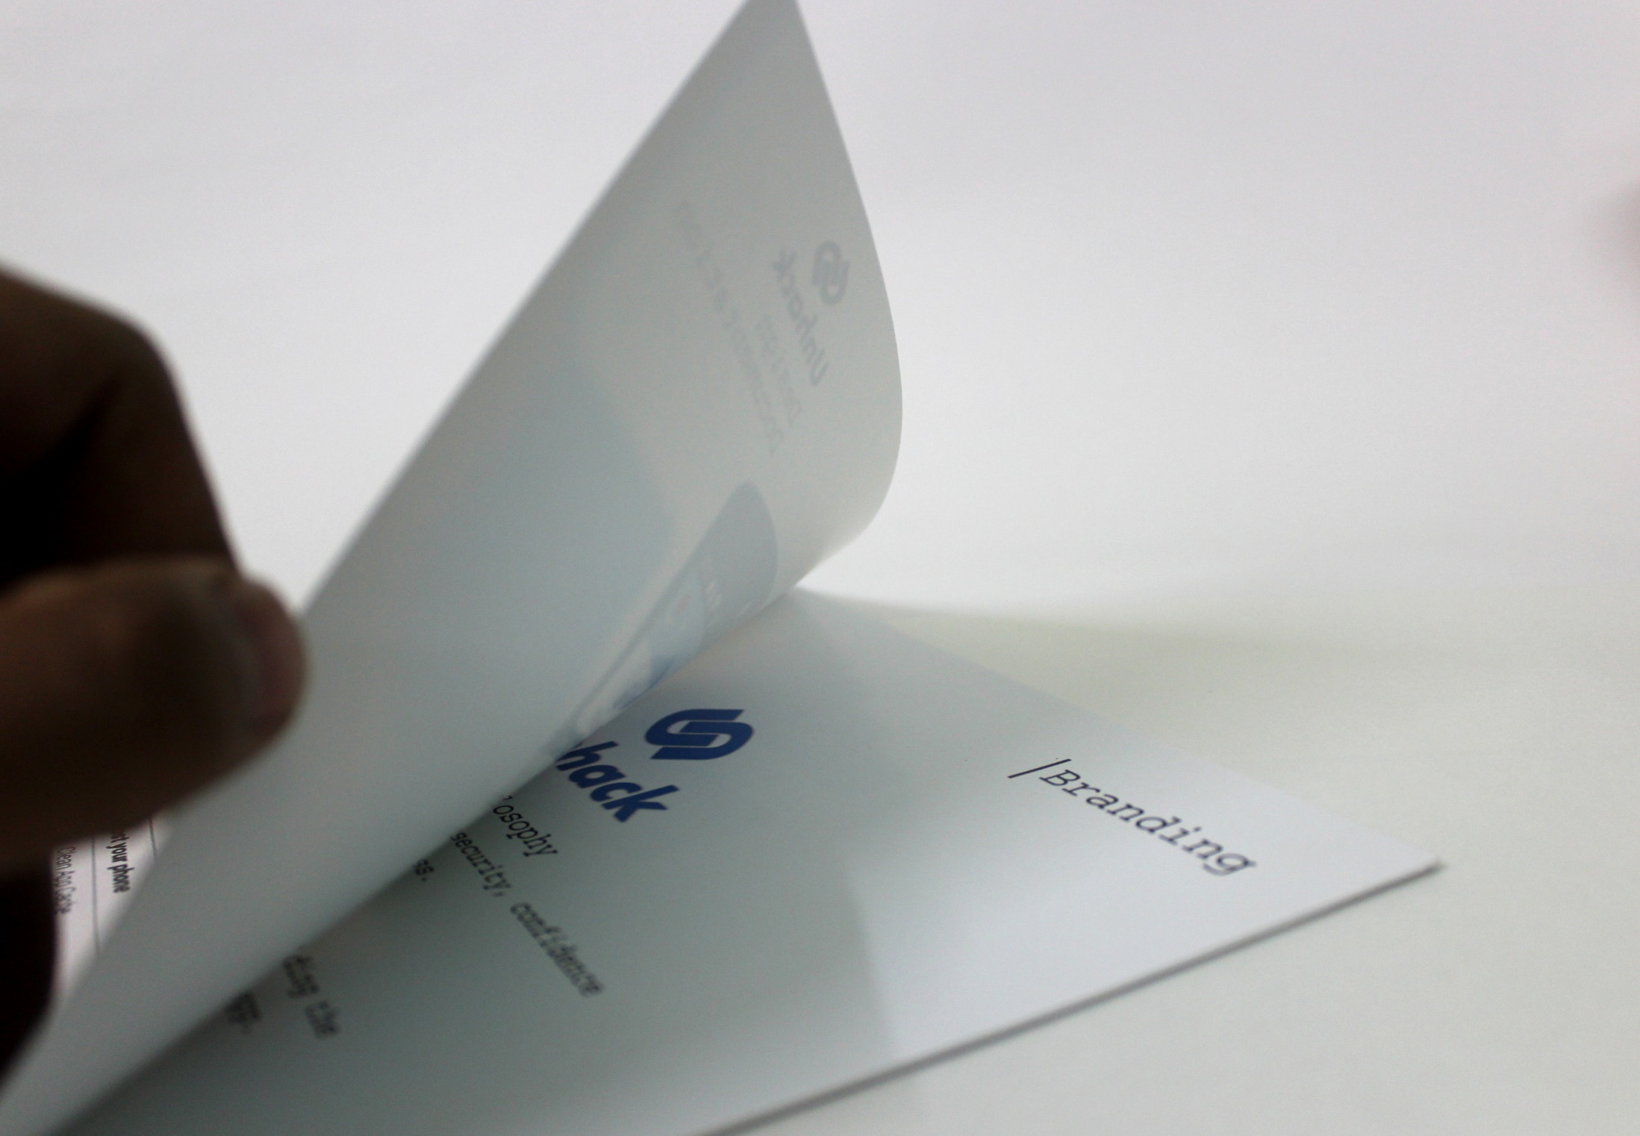

Slide 37
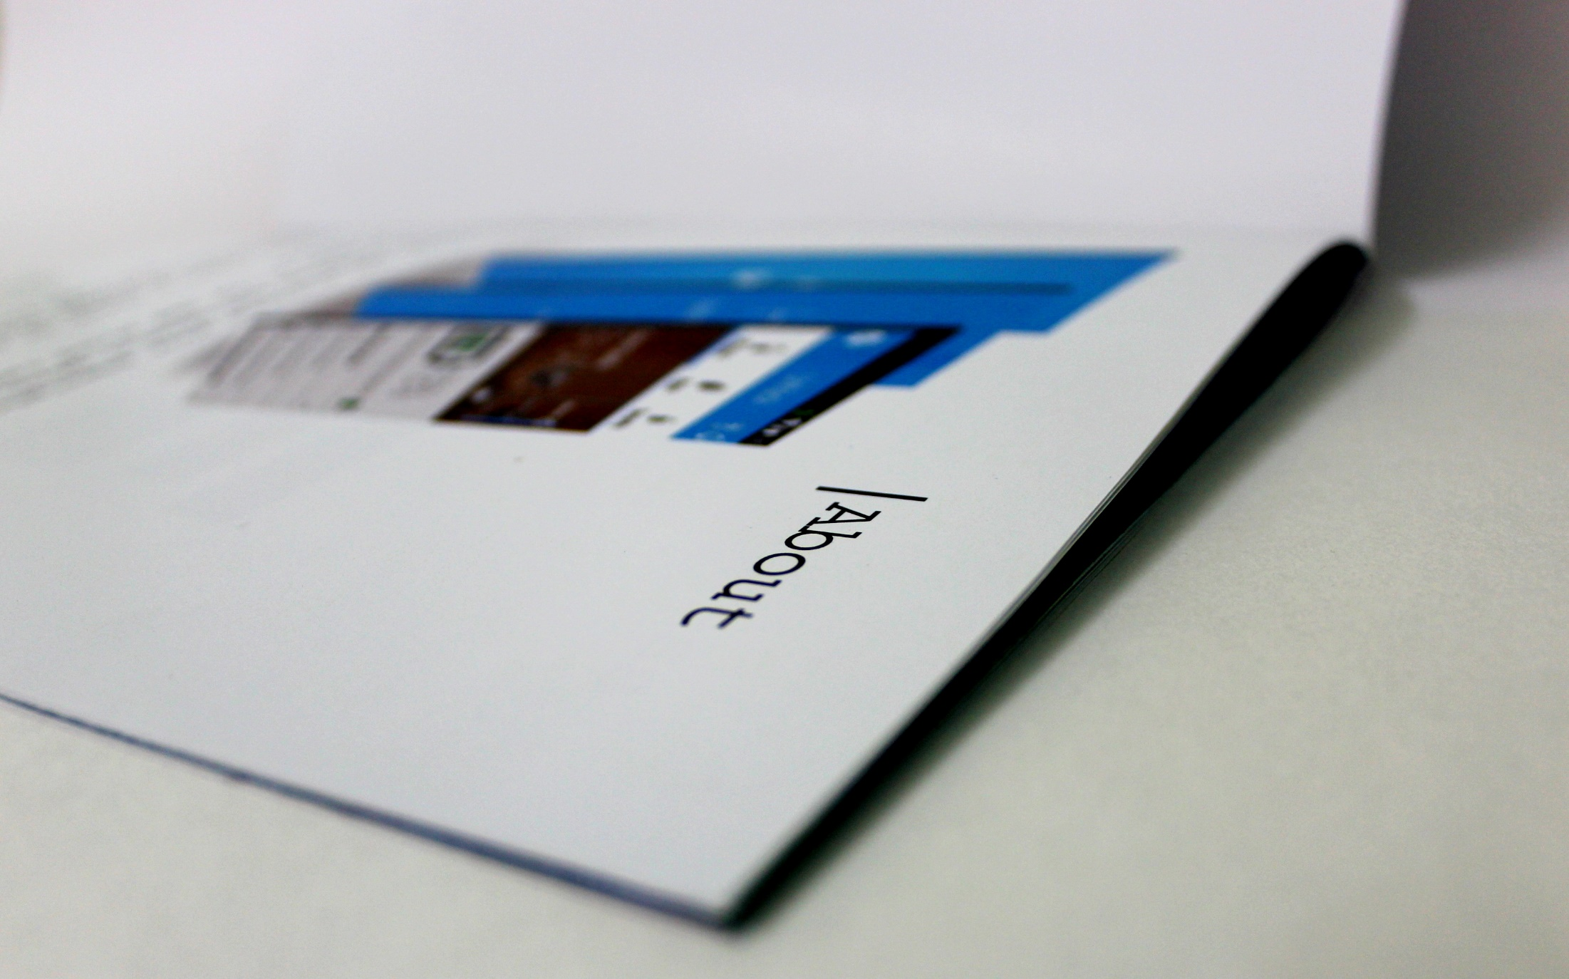

Slide 38
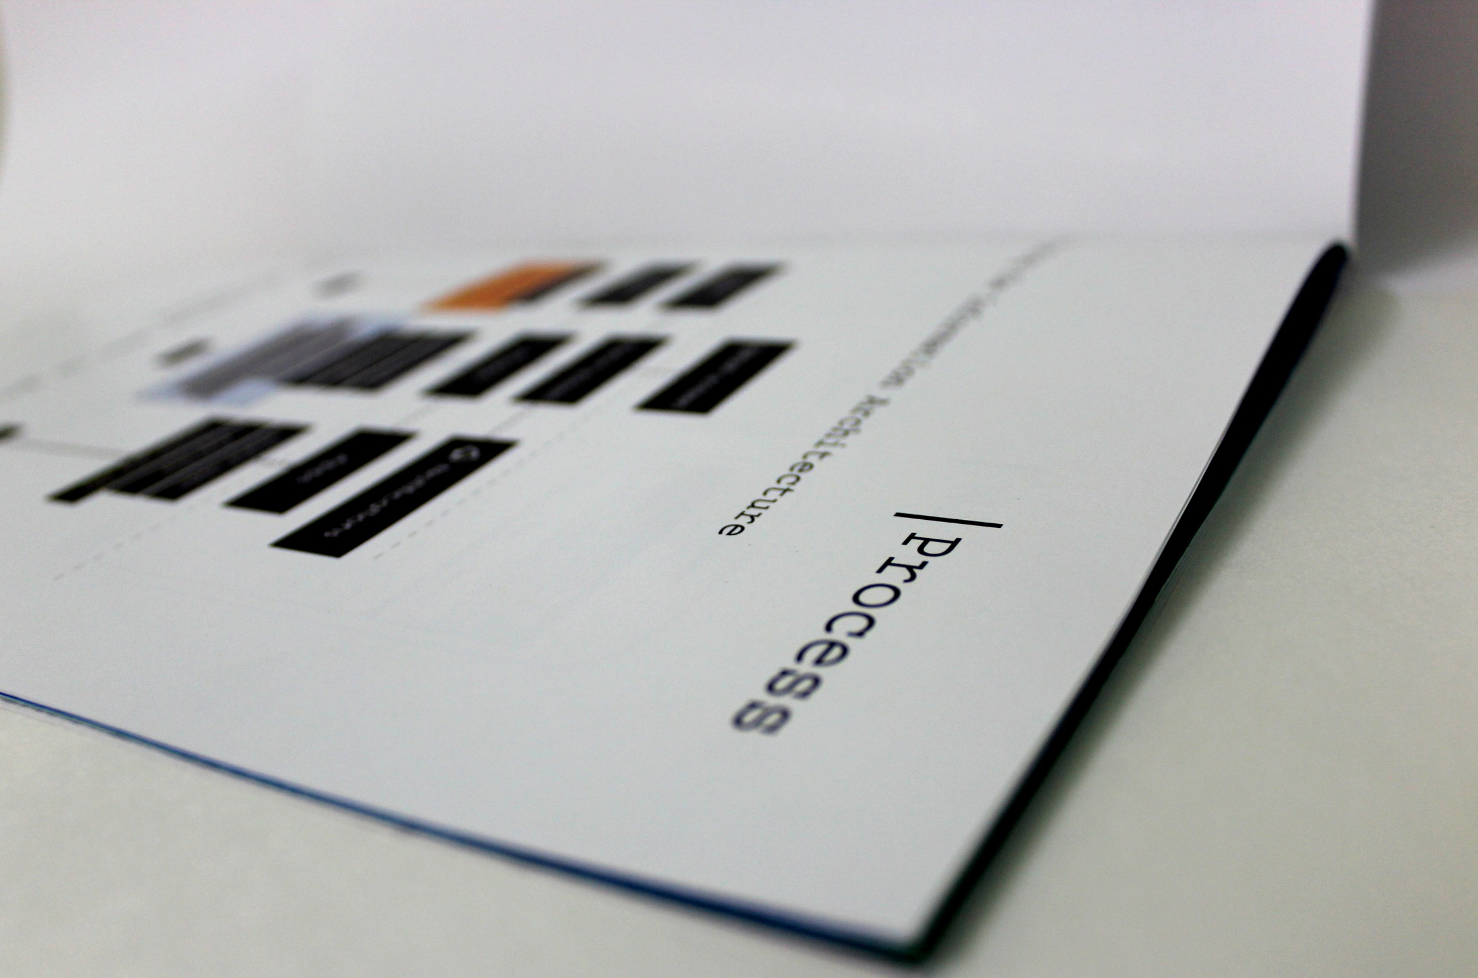

Slide 39
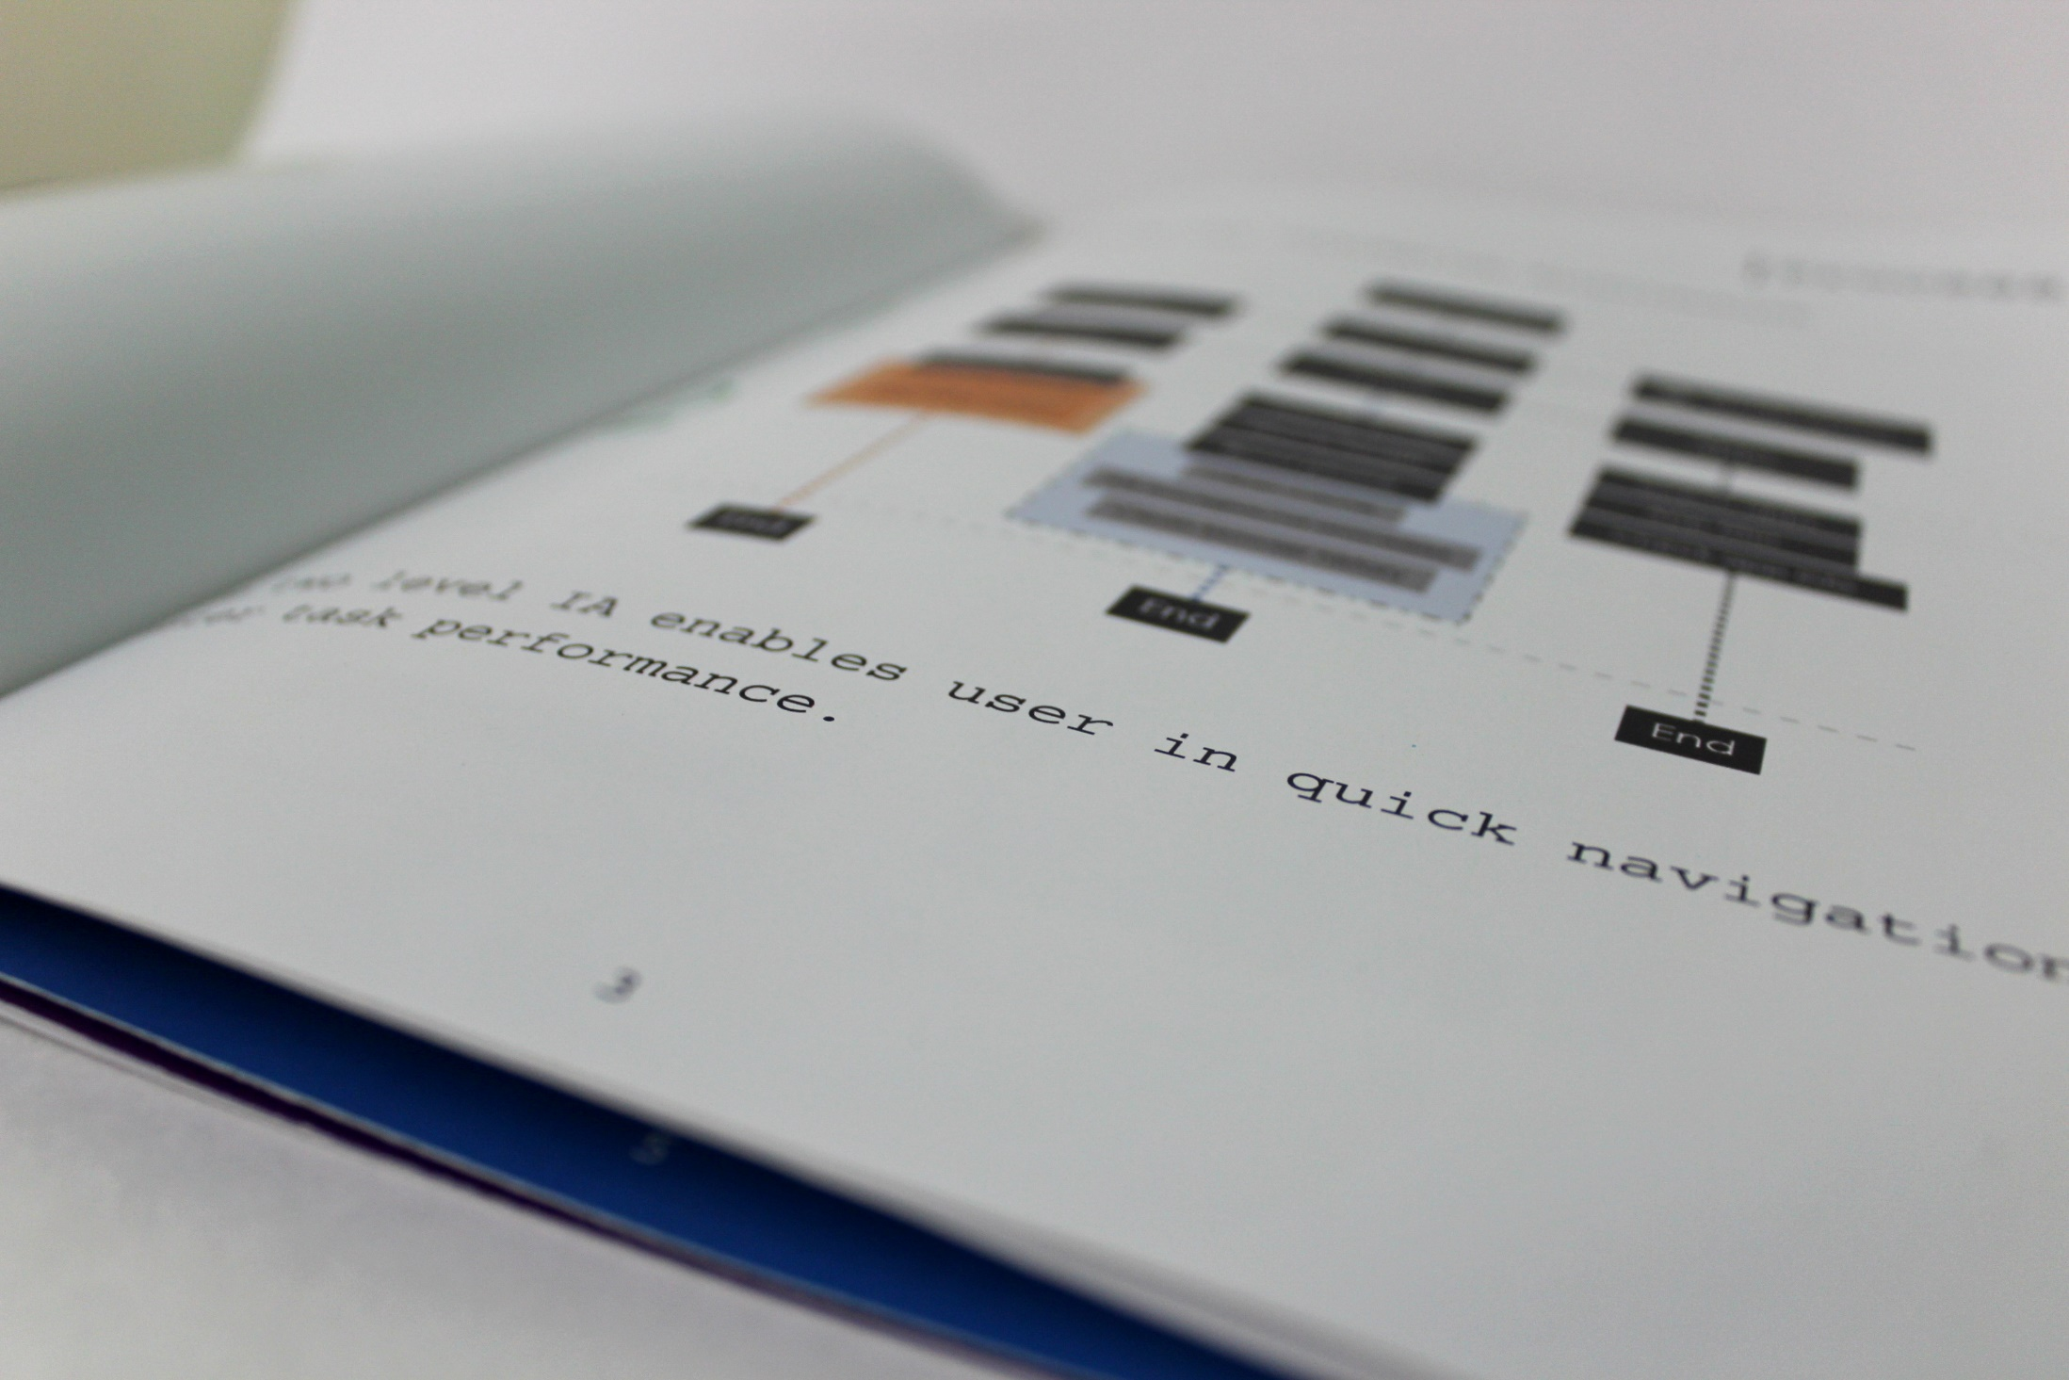

Slide 40
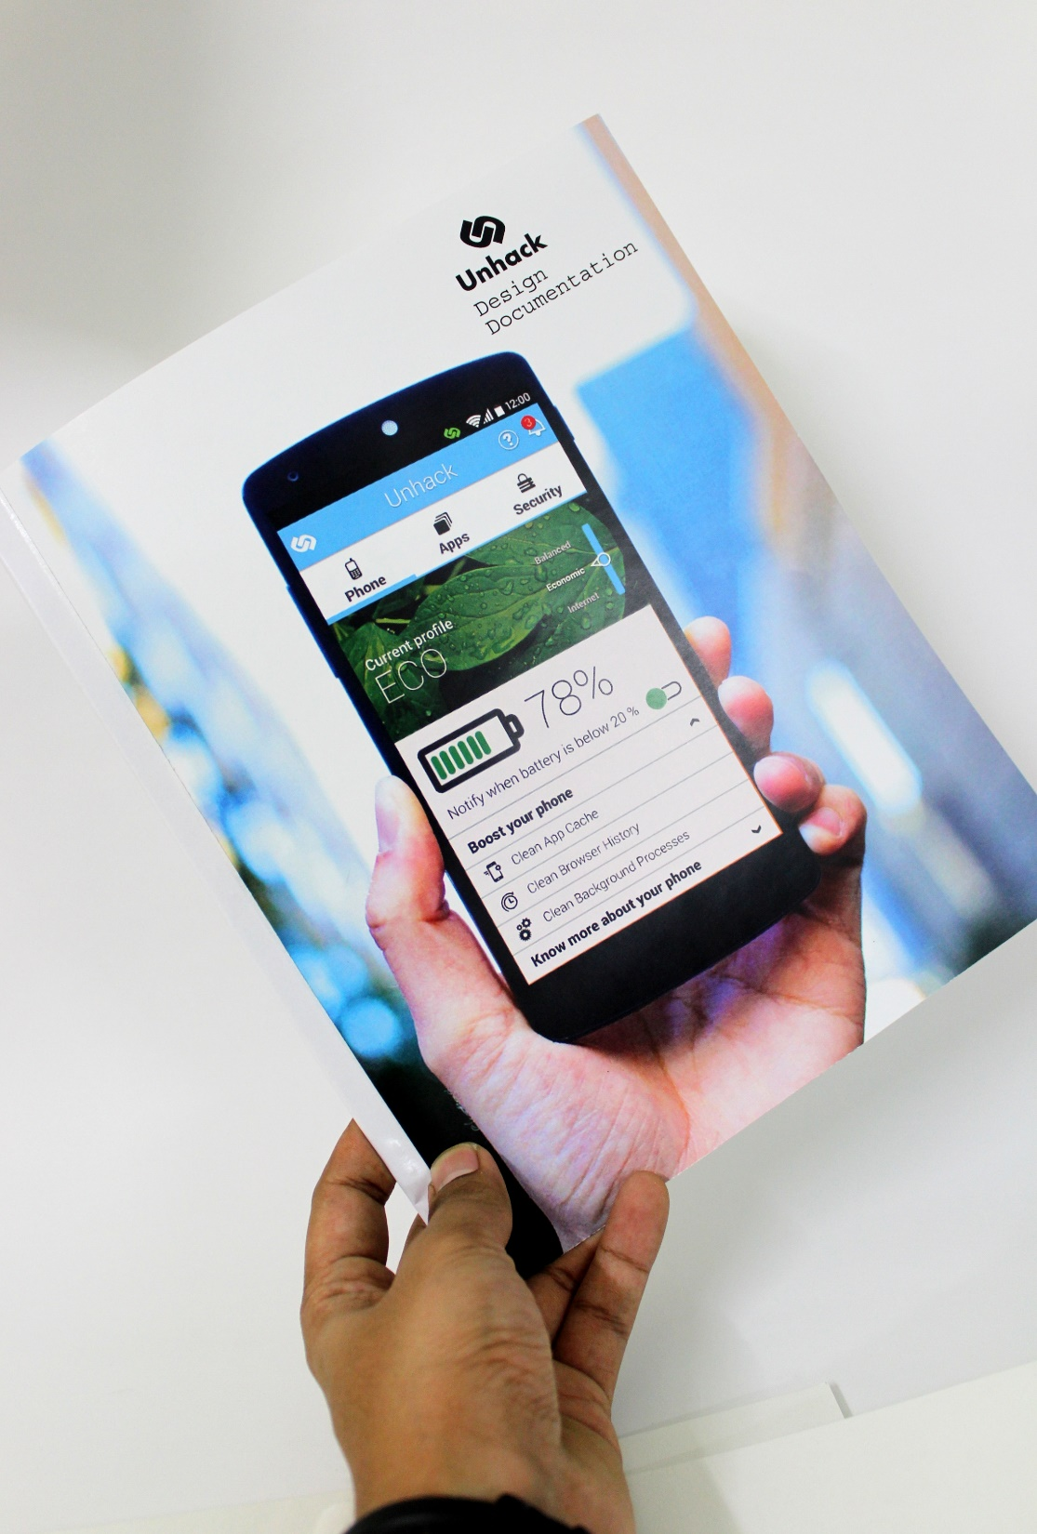
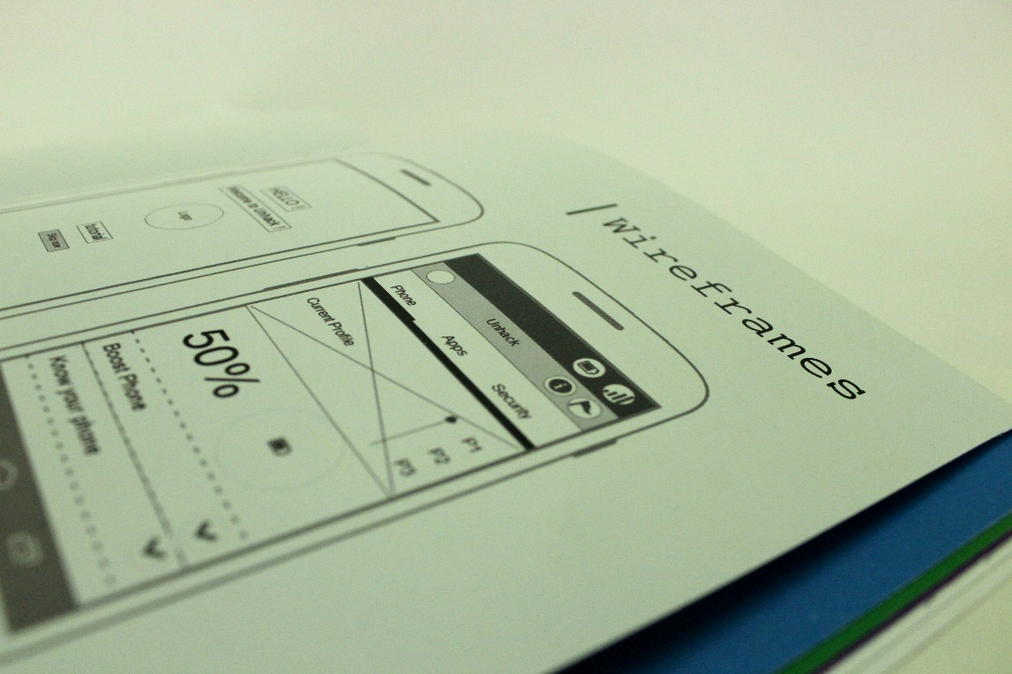
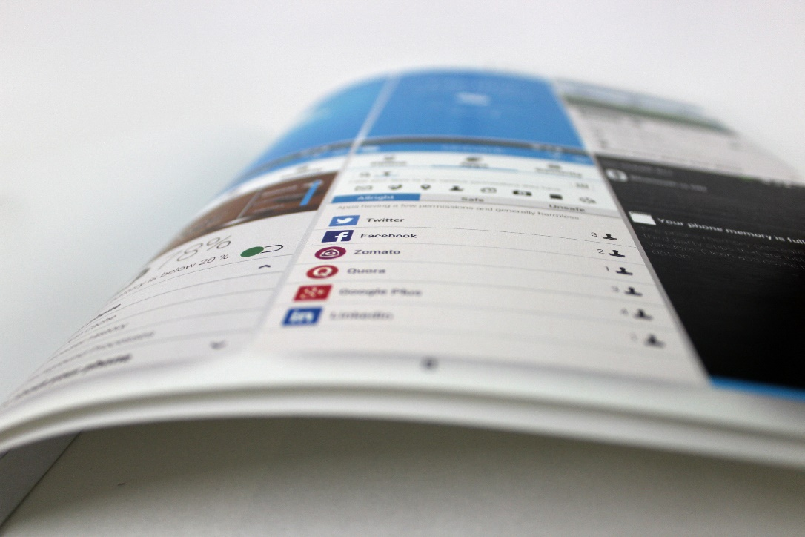

Slide 41
Fin.
Naveen Singh Rawat
146330011, IxD

